Slide 1
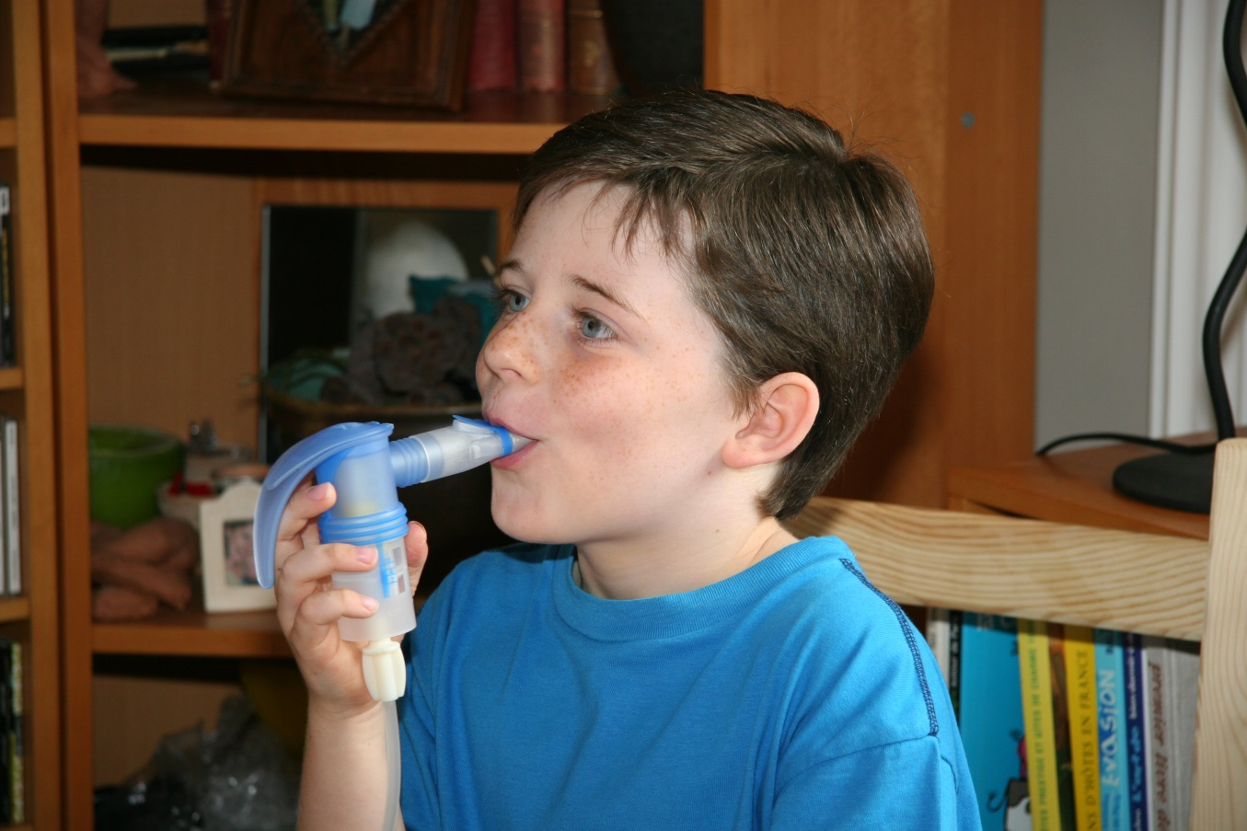
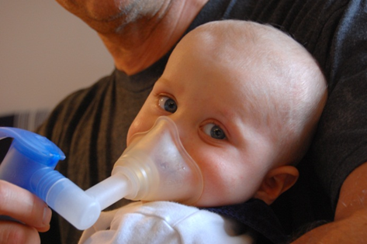
European Respiratory Society (ERS)
International congress 2015
Amsterdam, Netherlands, 26–30 September
PA1251
Session 123
Management of Asthma and other respiratory diseases in primary care
Inhalation Therapy with Hypertonic Saline (3%) – a Treatment Option for Airway Diseases in Children?
M. Koch¹, H. Mentzel², R. Ledermüller²
(1) Klinik Hochried, Zentrum für Kinder, Jugendliche und Familien, 82418 Murnau, DE
(2) PARI GmbH, Moosstr. 3, 82319 Starnberg, DE
Aims
Treatment Effects
The impact of treat-ment in terms of
bronchial secretion
dry cough
nervous cough
shortness of breath
course of the disease
was rated on average between 68-84% of the maximum points
Infections with rhinoviruses are the most common triggers for shortness of breath in pre-school children. The inhalation of hypertonic saline (HS) showed positive effects on the course of the disease [1,2]. In the past, even very young bronchiolitis patients were successfully treated with slightly hypertonic saline, an approach which currently is under discussion [3,4].
The inhalation of hypertonic saline is seen more and more as an efficient secretolytic option in the treatment of airway diseases in children. This survey is particularly looking after age and dia-gnosis of the patients receiving this treatment and the clinical results which can be achieved.
Table 3: Therapy effect on leading symptoms
Acceptance and Tolerability
The nebuliser therapy was well accepted (85%), the tolerability of the inhaled 3% saline was evaluated as very good (90%). Cough as side effect was reported in 6 of 156 cases (3.85%).
Absence from School or Child Care, Necessity of Additional Mucolytic Therapy
The average assessment regarding the reduction of days off was 72%, and regarding savings of further mucolytics was 80% of the maximum number of points.
Figure 1: Inhalation therapy with 3% hypertonic saline
Methods
In this multi-center, non-interventional, retrospective investigation, 43 private doctors/hospitals in Germany and Austria evaluated data from 156 patients who received inhalation therapy with 3% HS (Mucoclear®, PARI GmbH). A questionnaire was used to assess parameters like secretolysis, cough, shortness of breath, course of the disease, absence from school or kindergarten on a scale from 1 (no effect) to 10 (very good effect). Additionally, they reported acceptance, tolerability and side effects of the treatment.
Results
Patients‘ Age
27% of the 156 pa-tients receiving the 3% hypertonic sa-line inhalation thera-py were under 1 year old; 24% were 1-3 years of age, 18% 3-5 and 20% 5-10 years of age. Remaining 11% of the children were more than 10 years old.
Table 4: Acceptance and tolerability of inhaled 3% hypertonic saline
Table 5: Therapy effect on the reduction of sick-leave-days and the necessity of further mucolytic therapy
Core Area Acute and Chronic Bronchitis
A remarkably high num-ber of patients with bron-chitis (94/156, 60%) re-ceived the inhalation therapy with 3% HS. These patients bene-fitted more than the av-erage. Characteristic bronchitis symptoms like bronchial secretion, cough and shortness of breath were well in-fluenced and rated with 68-86% of the maximum possible points.
Table 1: Age distribution
Diagnoses
58% of the patients were diagnosed with bronchitis (38% acute, 20% chronic). 19% had bronchio-litis, 10% asthma, 5% croup syndrom and 3% cystic fibrosis (CF). There were also some patients with bronchiectasis, chronic rhinosinusitis, laryngotracheitis, lung hypoplasia and primary cilia dyskine-sia (PCD).
Table 6: Therapy effect on acute and chronic bronchitis symptoms
Conclusions
The consulted Austrian and German pediatricians used the well tolerated inhalation of 3% HS successfully up to the age of 10 and beyond. Patients, especially with acute and chronic bron-chitis, benefitted from symptom reduction, improved course of the disease, reduction of days-off and a decrease in additionally needed medication. The effect of the inhalation therapy with 3% HS in defined patient groups should be studied in further investigations.
Literature
Ater et al. 2012; Pediatrics 2012, 129,6,1397-1403
Ankermann et al. 2014; Atemwegs- und Lungenkrankheiten, 40, 9/2014: 407-415
Everard et al 2014; Thorax 2014, 69: 1105-1112
Zhang L et al. 2011; Cochrane Database Syst. Rev (4), CD 006458
Table 2: Diseases treated with inhaled 3% hypertonic saline
Conflicts of interest
Contacts: Dr. Markus Koch, Hochried 1-12, 82418 Murnau, Germany, koch@klinikhochried.de, www.klinikhochried.de
The author and the participating doctors and hospitals received refunding of their expenses by PARI GmbH
Co-authors are employees of PARI GmbH

